Slide 1
It's About People, Not Programs
Leveraging Differentiated Support to Build Principal Capacity
Notes:
Lindsay

Slide 2
Today’s agenda
Who we are
District context
Differentiated support: What is it? How does it work?
Reflection

Slide 3
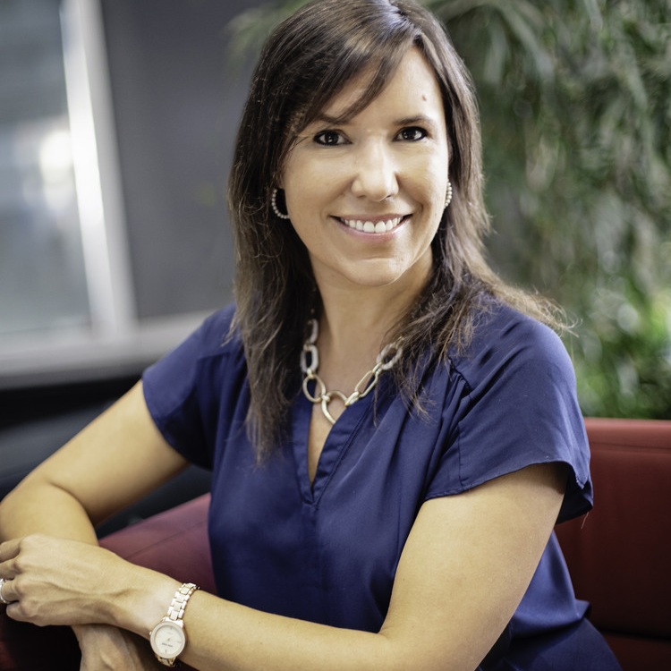
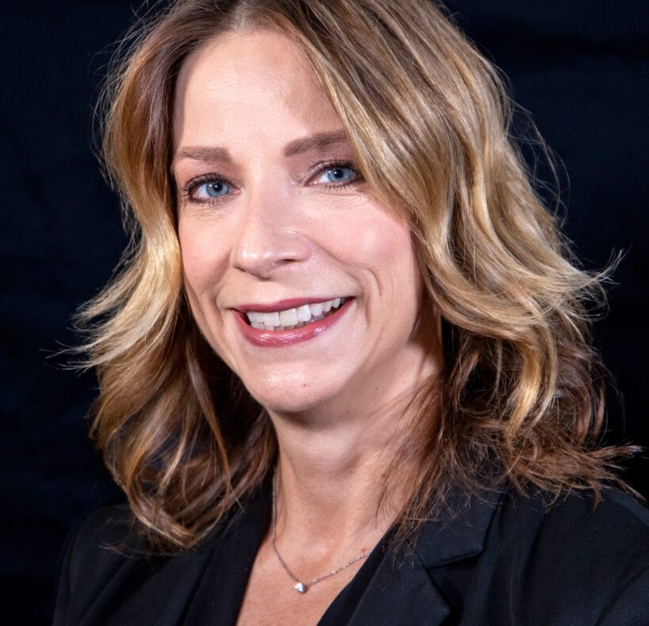
Who we are
Corbin Edington Manager, Professional
Learning Strategic
Accounts, NWEA
Dr. Lindsay Prendergast Professional Learning
Consultant, NWEA
Dr. Deanna Jaskolski
Region 3 Superintendent

Slide 4
Clark County School District
Nation's 5th largest school district
Serving over 300,000 students
More than 40,000 team members across the District
3 Regions and one Transformation Network to support school sites

Slide 5
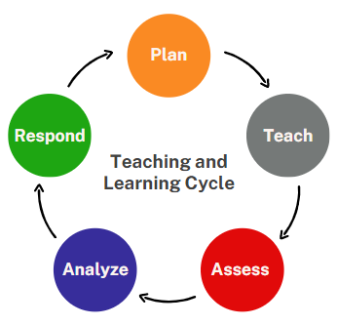
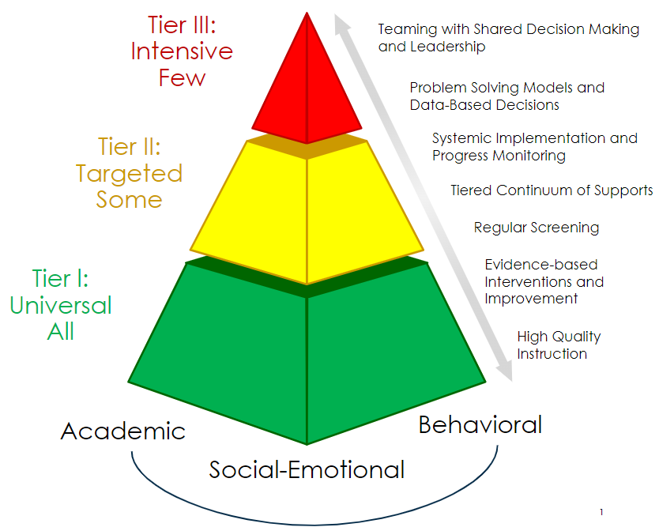
Notes:
Presenter:
Time: 1 Minute
Materials: N/A
Presenter: As MTSS represents our framework for academics, social-emotional, and behavioral learning, our Teaching and Learning Cycle is embedded within every Tier of MTSS. We plan, teach, assess, and analyze student data, and respond in every Tier. Based on the Tier, components within the cycle may be intensified and happen more frequently. The Teaching and Learning Cycle in Tier II will occur in smaller groups that are aligned to knowledge, skill, and/or concept deficit. We have also been working on our Professional Learning Communities framework, which is imbedded within the Teaching and Learning Cycle within “Plan” and “Analyze.” These processes work together to impact high-quality instruction to improve student outcomes.

Slide 6
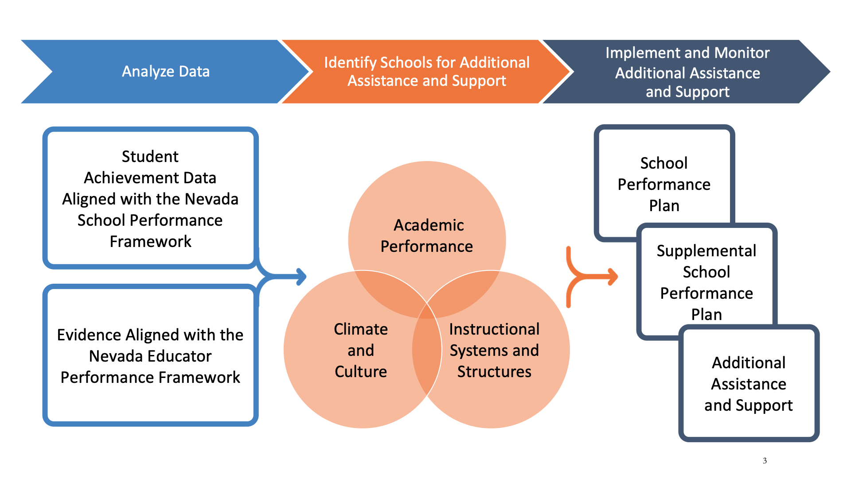
Differentiated School Support Framework

Slide 7
DIFFERENTIATED SCHOOL SUPPORT FRAMEWORK
Student Achievement
Continuous School Improvement
Support and Services
Accountability
Common Language

Slide 8
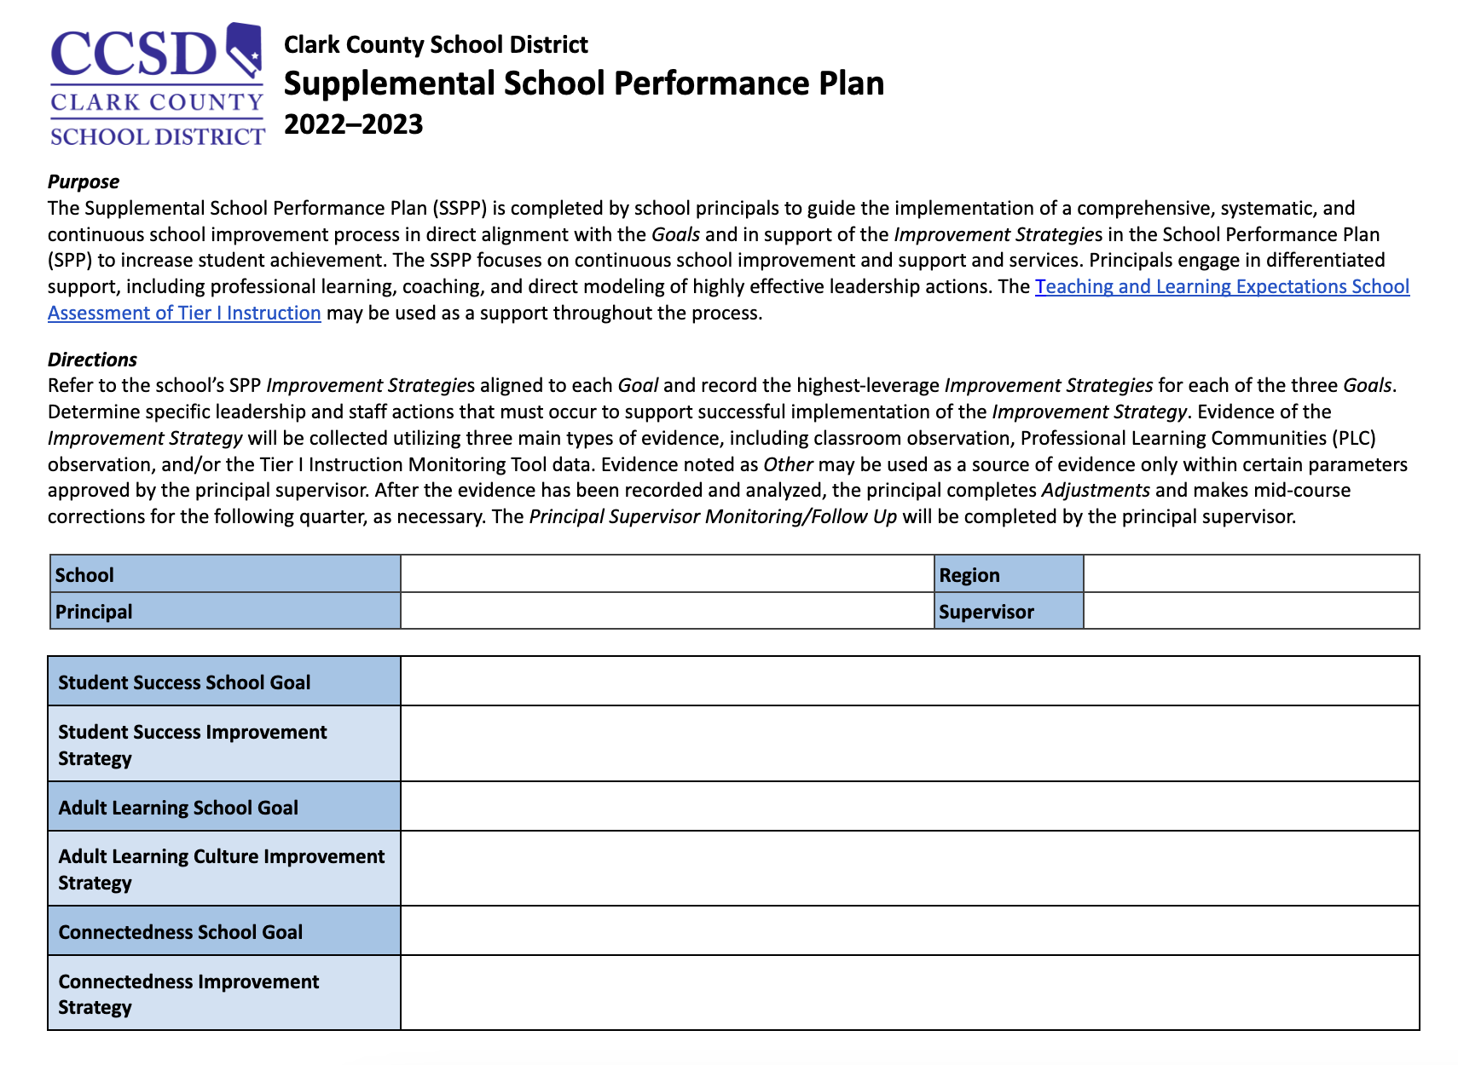
SUPPLEMENTAL SCHOOL PERFORMANCE PLAN
Plan
Roll Out
Execute
Monitor and Follow Up

Slide 9
Pause and Process
How does this information connect with what you are already doing in your district?

Slide 10
Leveraging Differentiated Support to Build Principal Capacity
High Expectations +
Deep Support = Increased
Success for All Students
Notes:
Lindsay starts

Slide 11
NWEA partnership with CCSD
MAP Growth K-10, MAP Accelerator, MAP Reading Fluency
District Support
Region Support Team Coach for each Region
Aligned to Region and school site needs
20 schools per coach
Differentiated

Slide 12
Areas of Support
Academic Content Standards: Understanding and Use
Culture of Data Use
Long Range Professional Learning

Slide 13
Academic Content Standards: Understanding and Use
Supporting PLC design and implementation
Unwrapping standards: modeling, coaching
Examining task alignment to standards
Fostering assessment literacy
Notes:
Lindsay
Share a specific story/example -one from district, one from school

Slide 14
Culture of Data Use
Instructional rounds: direct coaching, peer observations, examining trends to inform professional learning and support
Data use cycles: assessment literacy coaching, informing strategic support using data, fostering a culture of inquiry
Feedback: focused on professional growth areas, centered around informing ongoing support
Notes:
Lindsay

Slide 15
Long-Range Professional Learning
Supporting school sites in aligning needs based on embedded supports
Serving as a thought-partner with leaders to differentiate support for teachers
Example: District Professional Learning Initiative
Redelivery
Context
Bite-sized
Applicable
Notes:
Corbin

Slide 16
Regarding the design of the differentiated support NWEA provides to schools in CCSD, choose one prompt to respond to with a colleague
•An "Ah Ha" - something you had not thought of before
•An affirmation – something that makes sense, or aligns with your existing knowledge
•An "I wonder..."

Slide 17
Key Elements of Successful Design
Through-lines of communication at all levels of leadership
Explicit alignment of support to district initiatives - coaches are an “extension” of Region Superintendents and Supervisors
Adapting support of principals to unique scenarios and current reality
Leveraging data for ongoing impact analysis
Notes:
Corbin & Lindsay start, Deanna continues

Slide 18
Outcomes & Reflections
Alignment of professional learning for leaders to strategic district initiatives around instructional leadership
High-need school communities receiving comprehensive support to address student opportunity gaps
Laser-like focus on school improvement goals

Slide 19
Considerations for Practice
Application and Implementation

Slide 20
Table Discussion
What are your current priority initiatives in your District?
Where is your District's professional learning focused?
Are there opportunities to enhance alignment across priorities and professional learning?

Slide 21
Thank you!
Dr. Deanna Jaskolski, Region 3 Superintendent
Corbin Edginton, Manager, NWEA Strategic Accounts
Dr. Lindsay Prendergast, Professional Learning Consultant, NWEA

