Slide 1
June 12-13, 2023
Harrah’s Lake Tahoe

Slide 2
Leaders…..
Together We Rise:
Shaping Education for Today, Tomorrow & Beyond!

Slide 3
Sunday, June 11, 2023
Early Bird Dinner - Superintendents, Guests & Retirees Only
Location: Summit Room – Harrah’s
6:00 p.m. - Cocktails
6:30 - 8:00 p.m. – Dinner
Hosted by: NWEA

Slide 4
Monday, June 12, 2023
NASS Meeting - Superintendents/NDE/Guests Only
Location: Sand Harbor III
7:30 a.m. - Hosted Working Breakfast Provided – Care Solace
8:00 a.m. - NASS meeting begins
Regular Agenda Items
Announce 2023 Superintendent of the Year
Noon (or earlier) - Meeting Ends

Slide 5
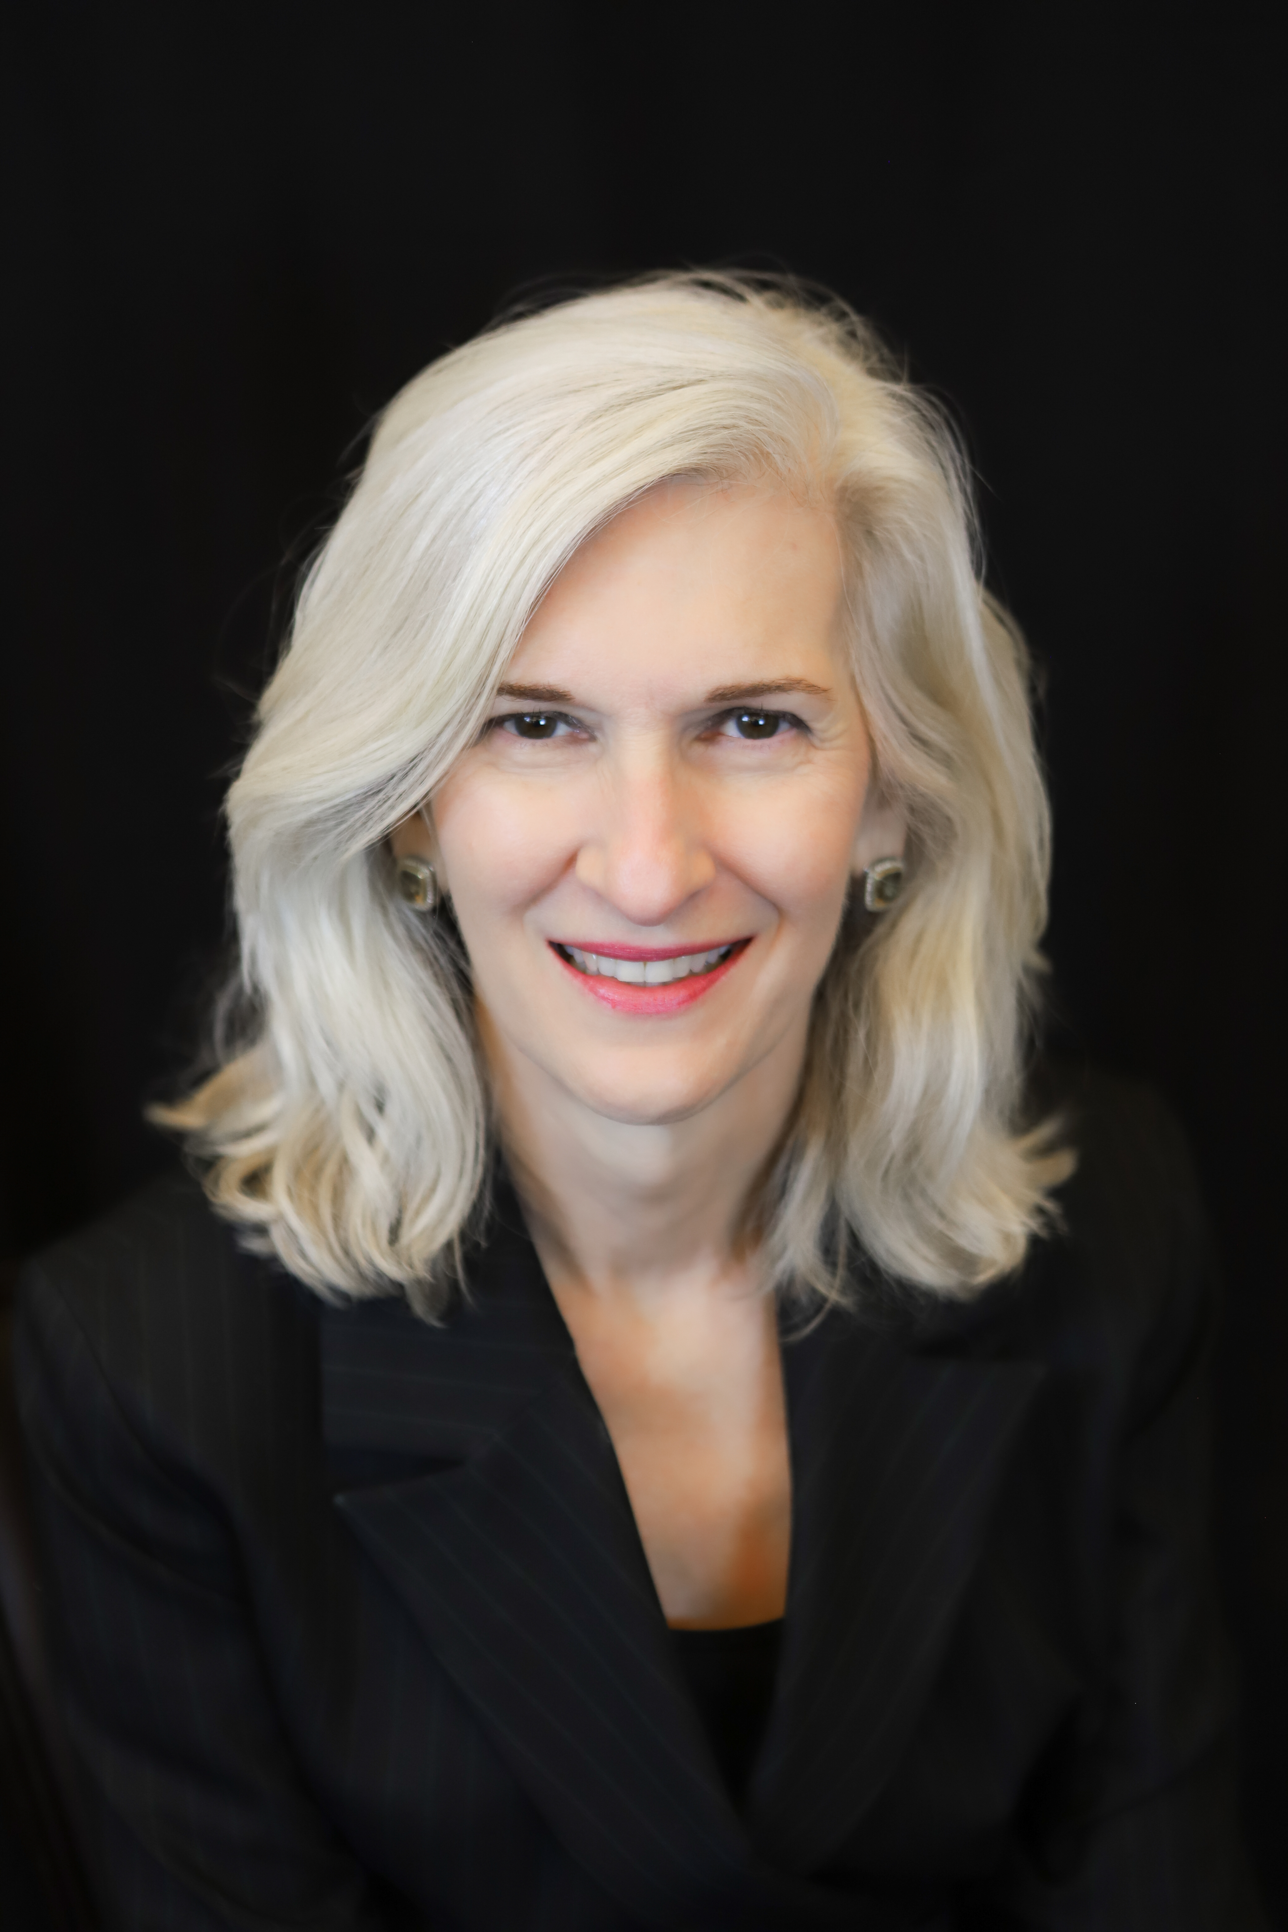
Monday, June 12, 2023
Details
8:00 a.m. – Noon NASS Business Meeting
(Breakfast Starts 7:30 a.m.)
1:00 - 1:05 p.m. Welcome & Introductions
1:05 - 1:15 p.m. Opening Remarks - Sylvia Diaz, Superintendent in
Residence, McGraw Hill/Achieve3000
1:15 - 2:30 p.m. Keynote: Sean Covey
2:30 - 2:45 p.m. Break
2:45 - 4:45 p.m. Workshop
5:00 - 6:30 p.m. Social hour – Light Hor d’oeuvres

Slide 6
Monday, June 12, 2023
Book:
The 4 Disciplines of Execution for Educators:
Achieving Your Wildly Important Goals
Keynote: Sean Covey

Slide 7
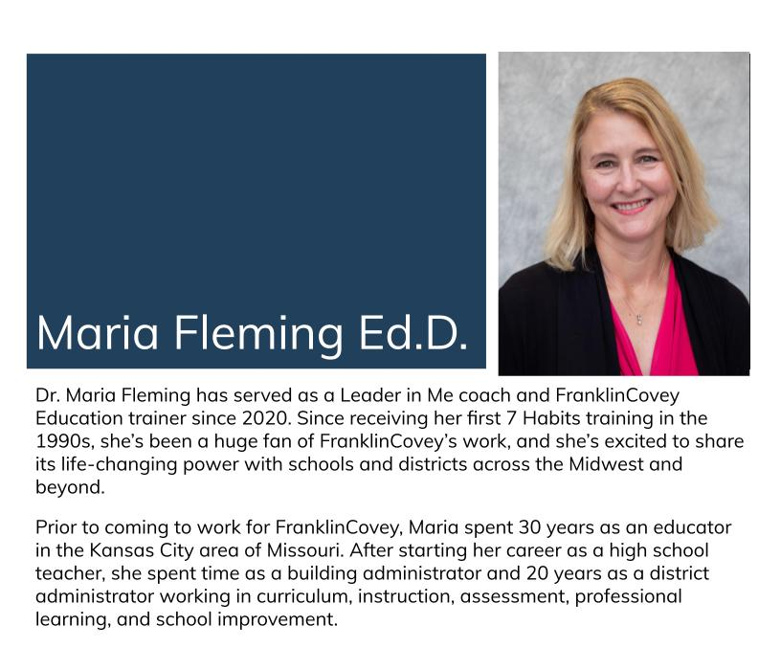
Monday, June 12
Follow Up Workshop
Bring your teams
Bring your Strategic Plan
Bring your vision!

Slide 8
Tuesday, June 13, 2023
Details
7:30 - 8:45 a.m. Breakfast
8:15 - 8:45 a.m. Federal Education Update, Sasha Pudelski, AAA’s Director of Advocacy
8:45 - 9:00 a.m. Break
9:00 - 11:10 a.m. Breakout sessions (5 options X 2 rounds)
11:10 - 11:25 a.m. Transition
11:25 a.m.- 12:30 p.m. Lunch
12:00 -12:15 p.m. Dr. Summer Stephens, Honoring Superintendent of the Year
12:15 - 1:30 p.m. Keynote: Sam Glenn
1:15 - 1:30 p.m. Conference Closure
1:45 - 3:45 p.m. NV Future of Learning Network Continues (optional for NASS)

Slide 9
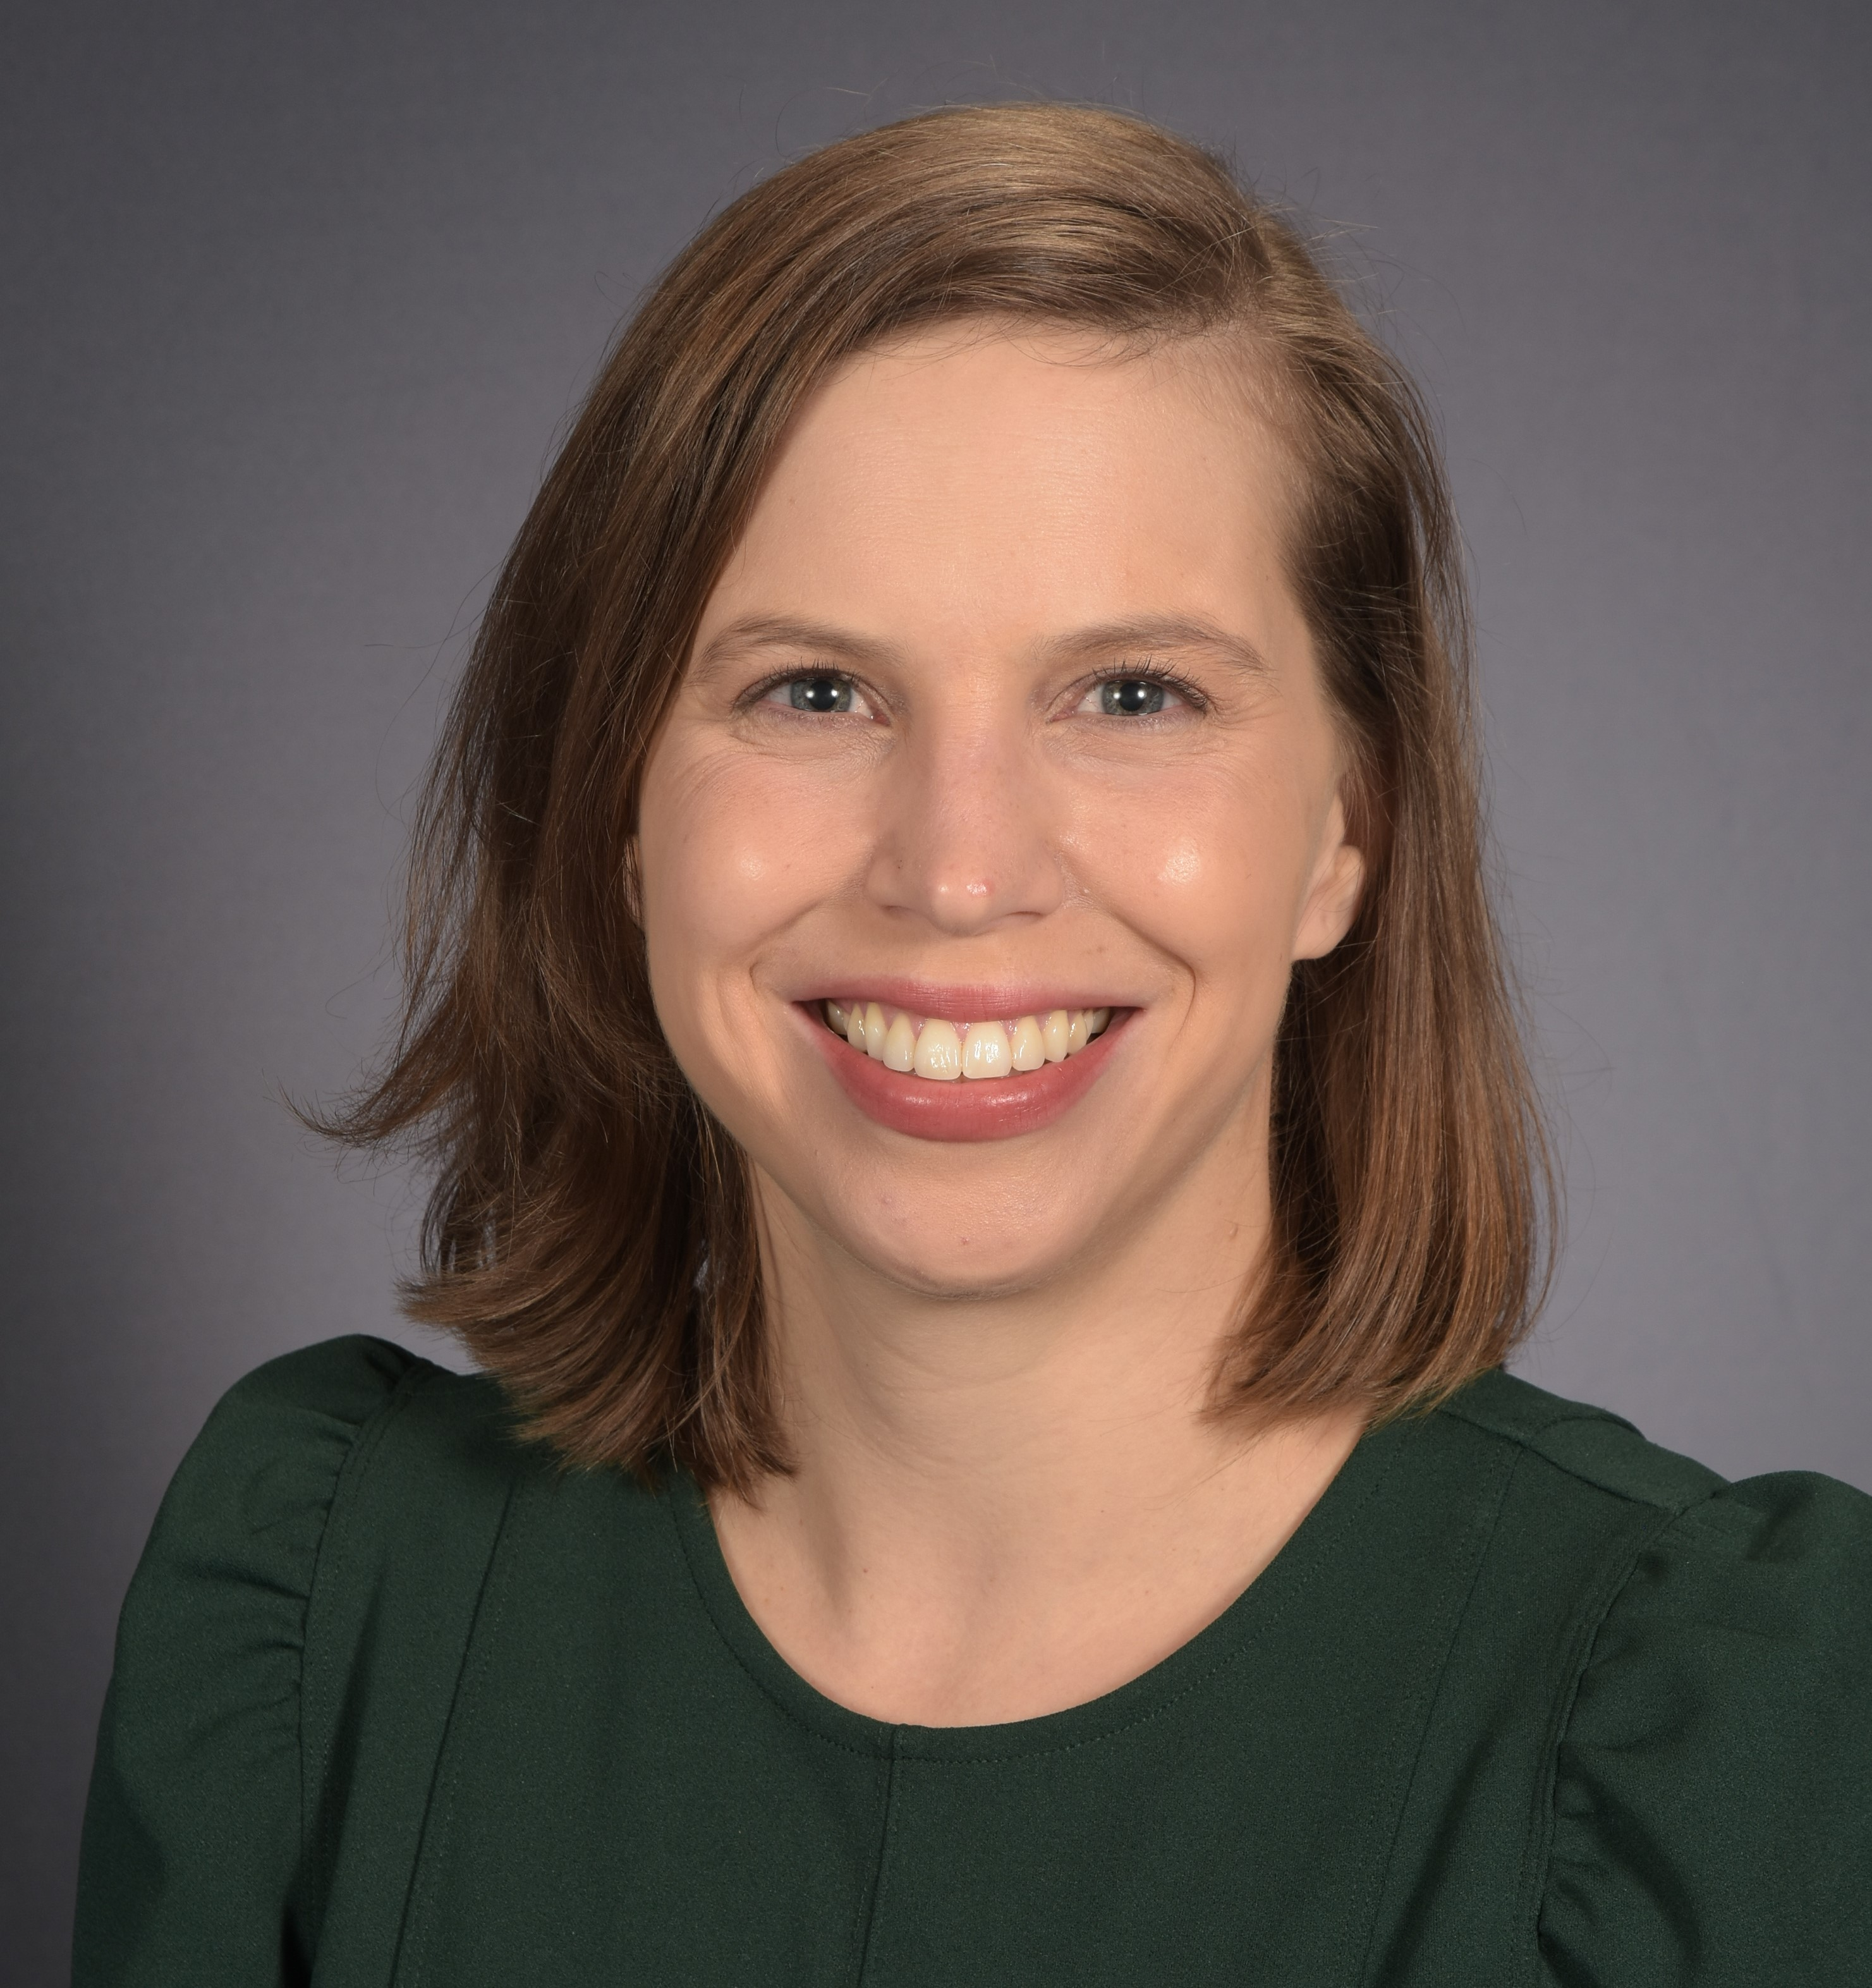
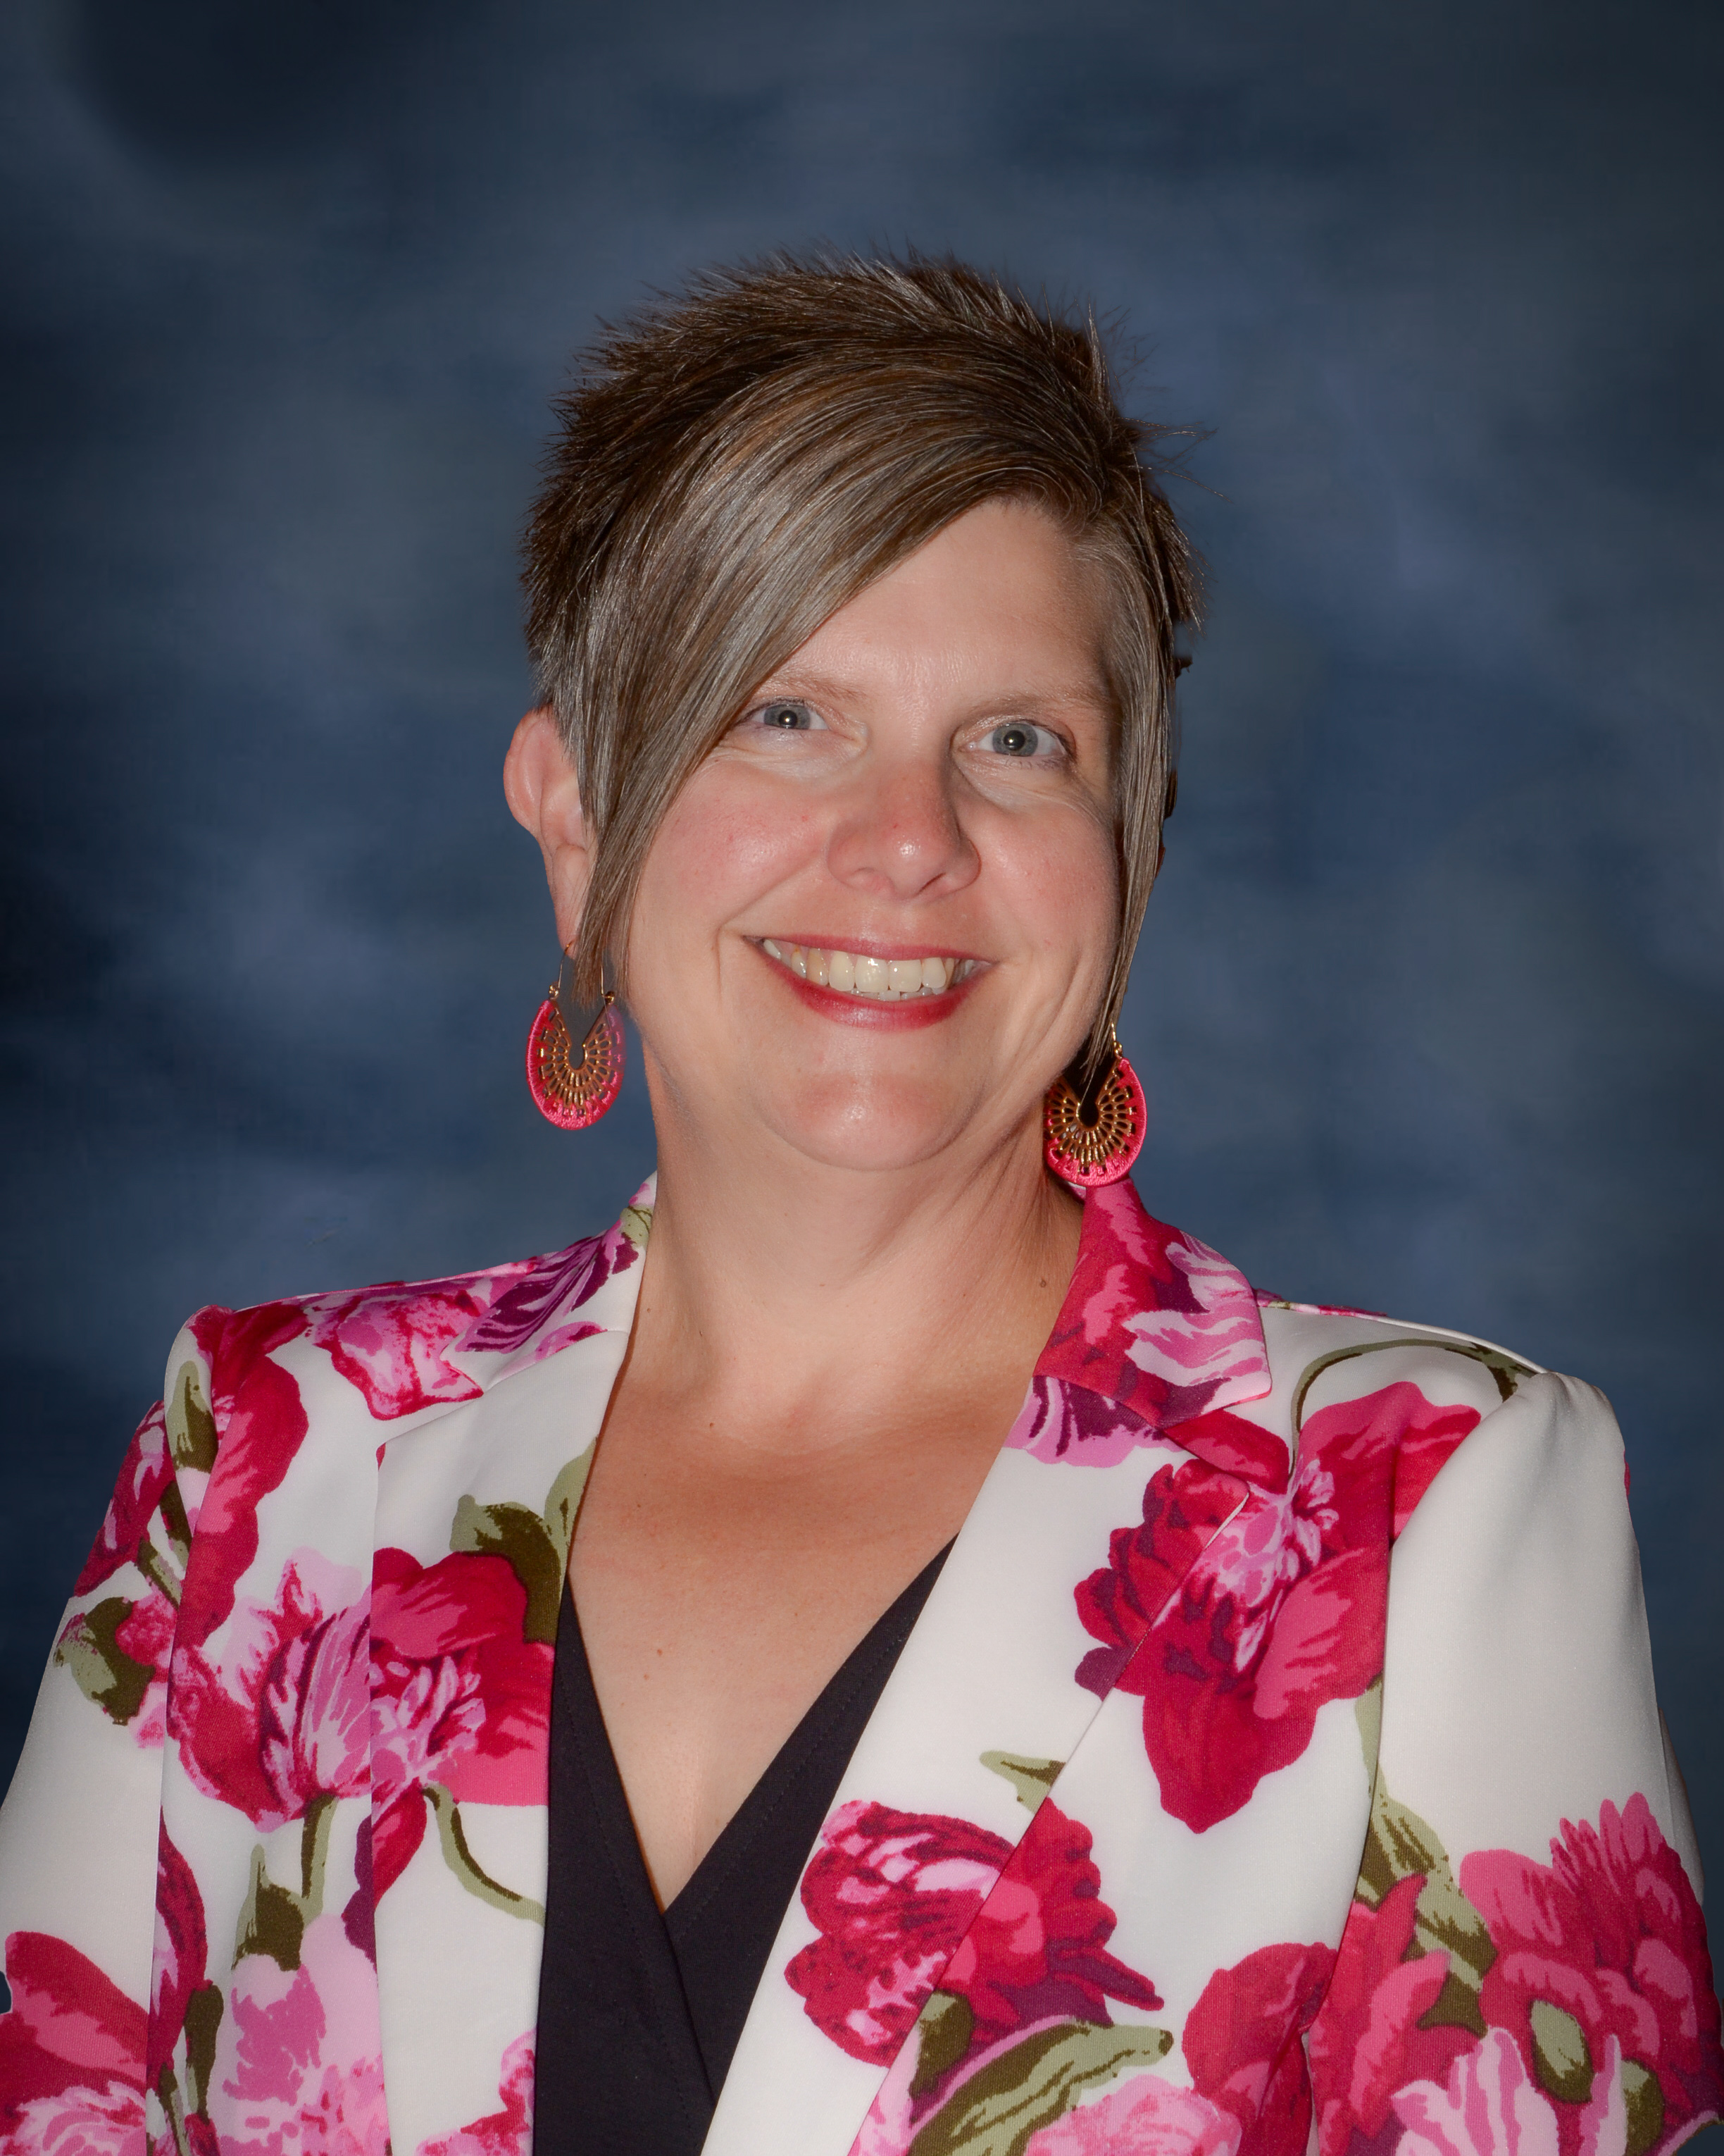
Tuesday, June 13, 2023
Sasha Pudelski, AASA’s Dr. Summer Stephens, Advocacy Director 2023 Superintendent of the
Year - Nevada

Slide 10
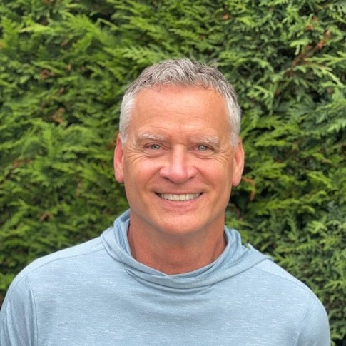
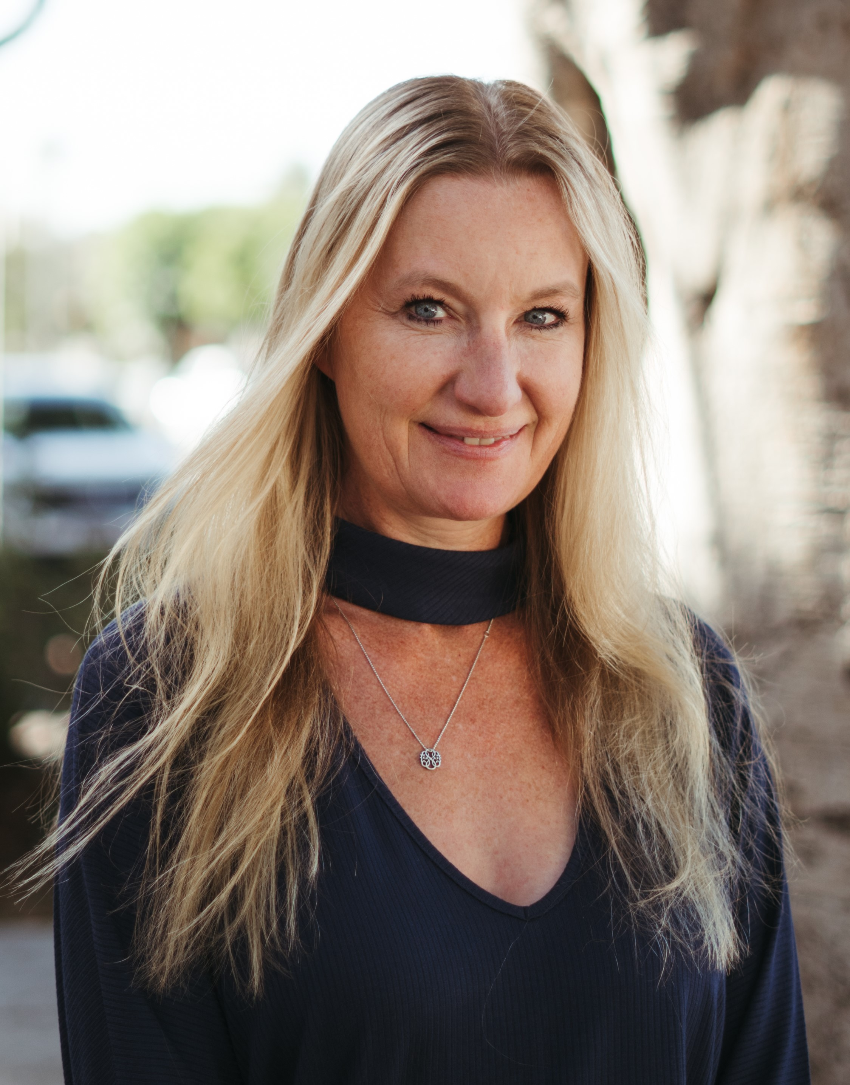
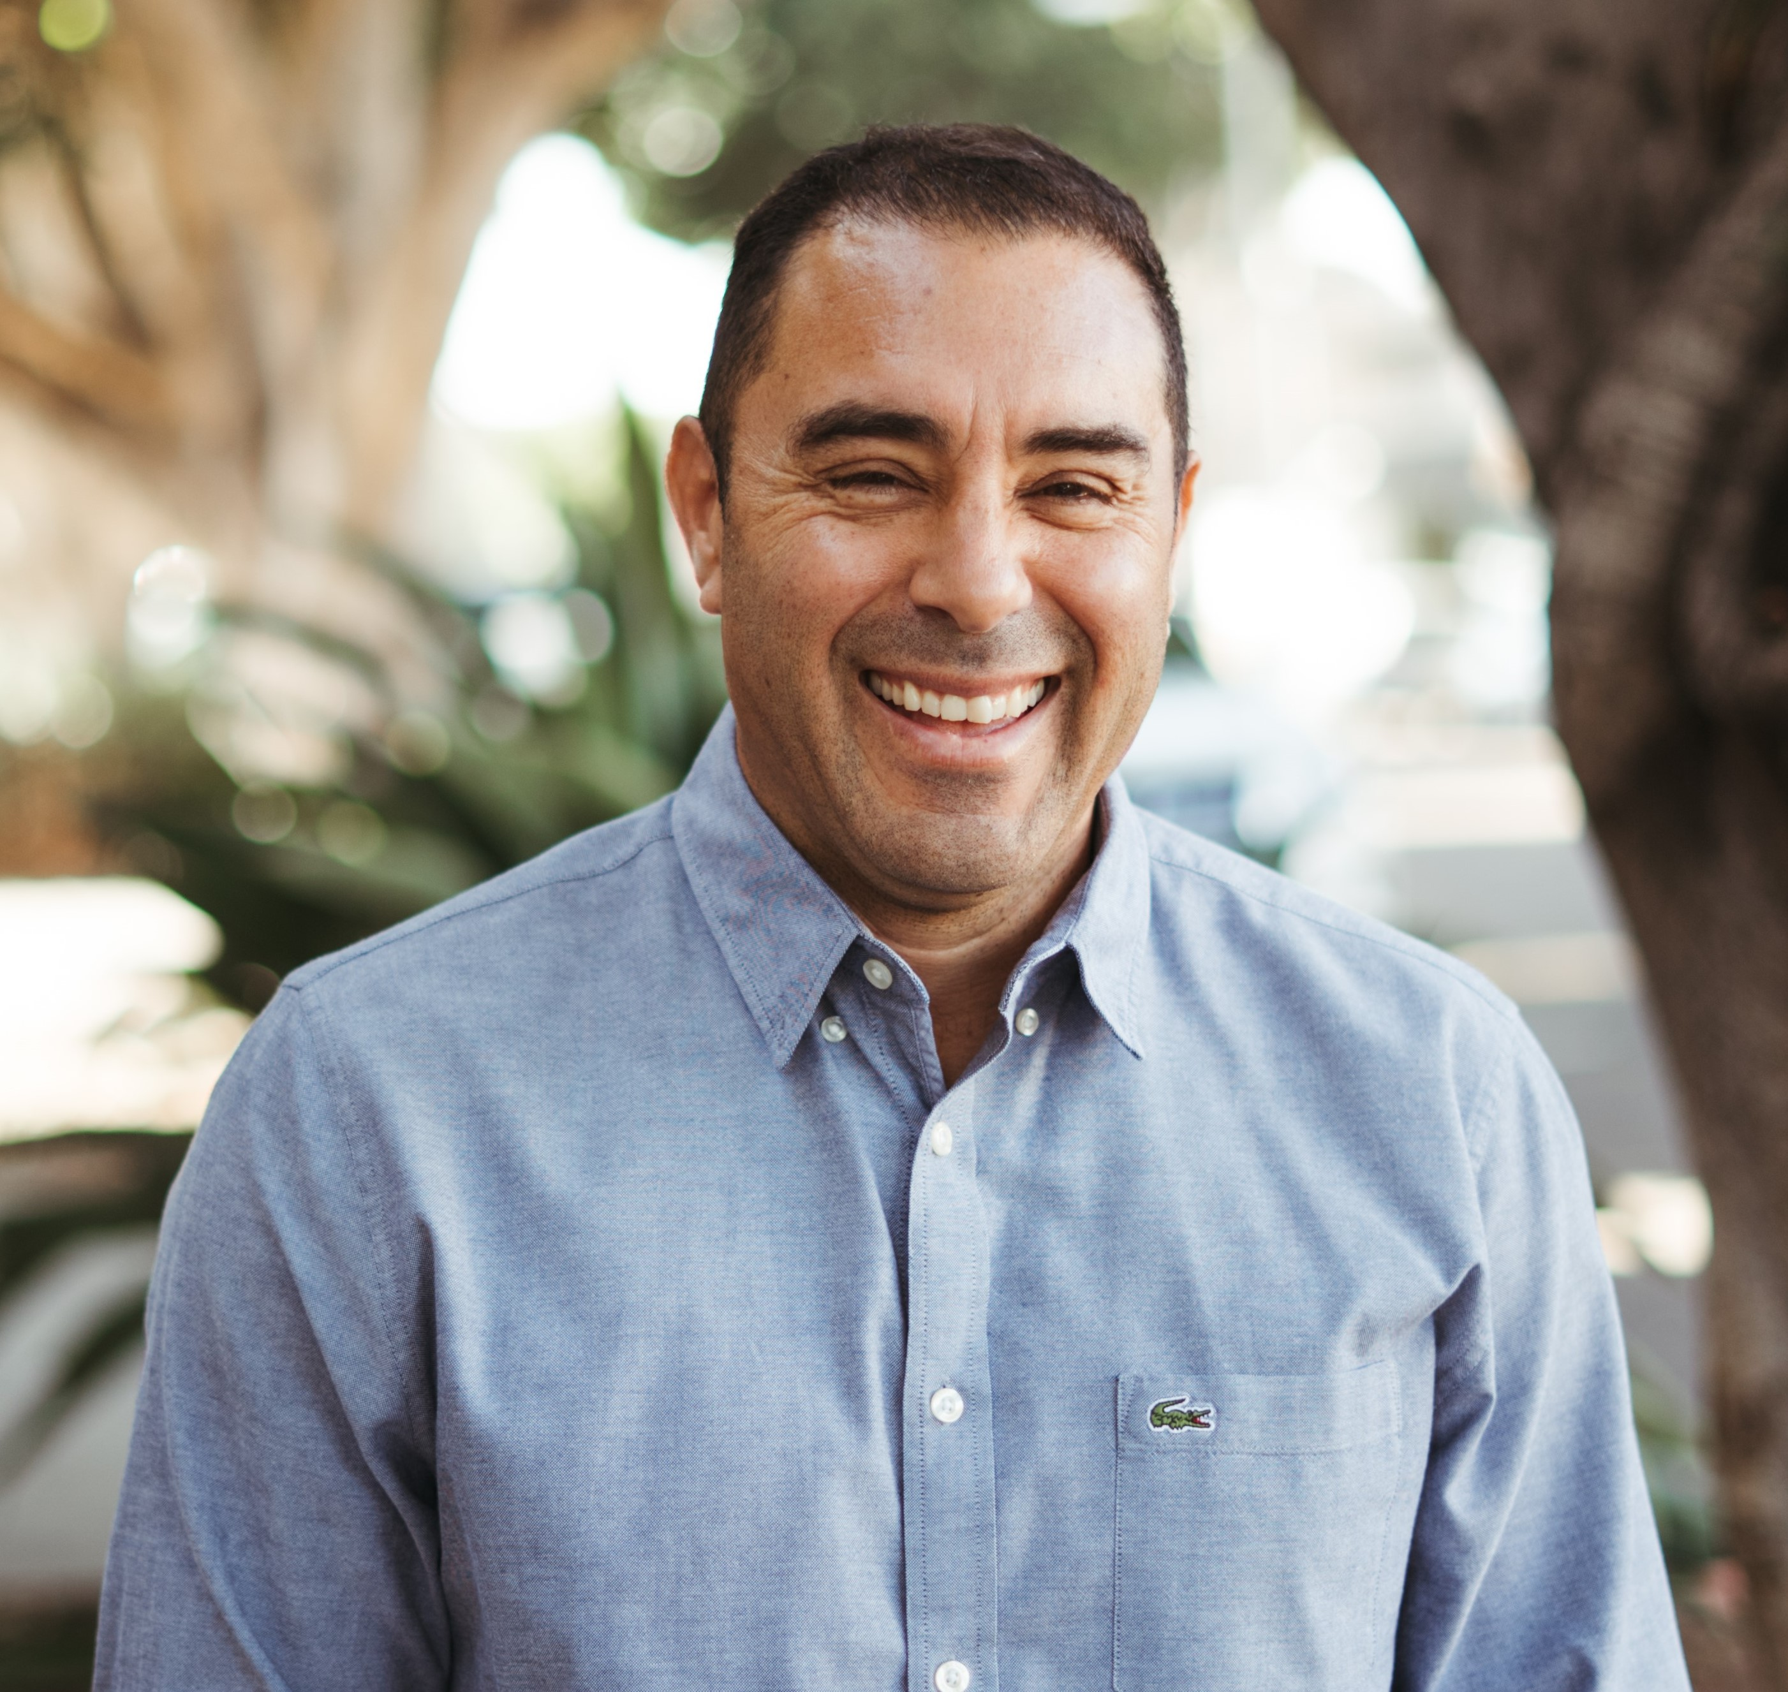
Tuesday, June 13, 2023 (Breakout Session)
Dr. Marty Schafer Jenean Fear
Superintendent & the Mindful Leadership & Equitable Approaches to Create
School Board Healthier School Communities

Slide 11
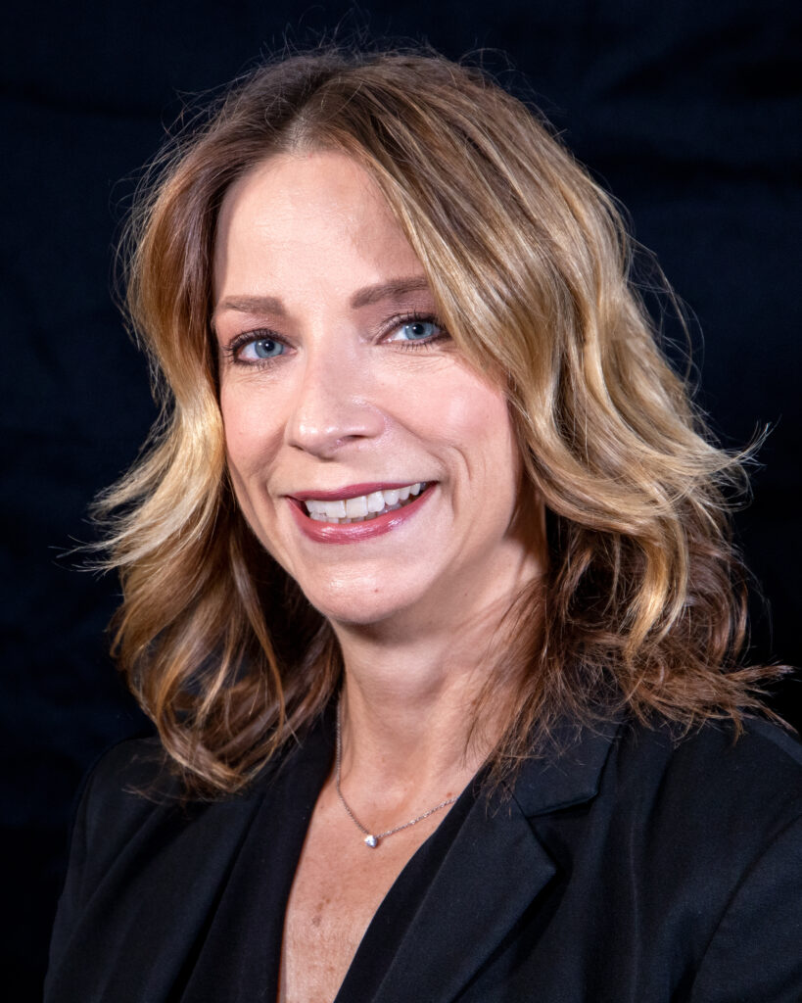
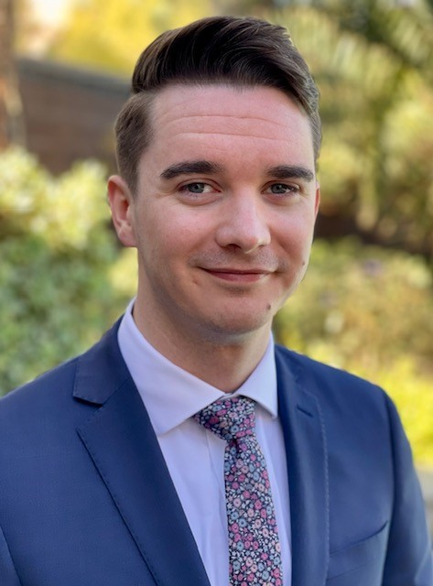
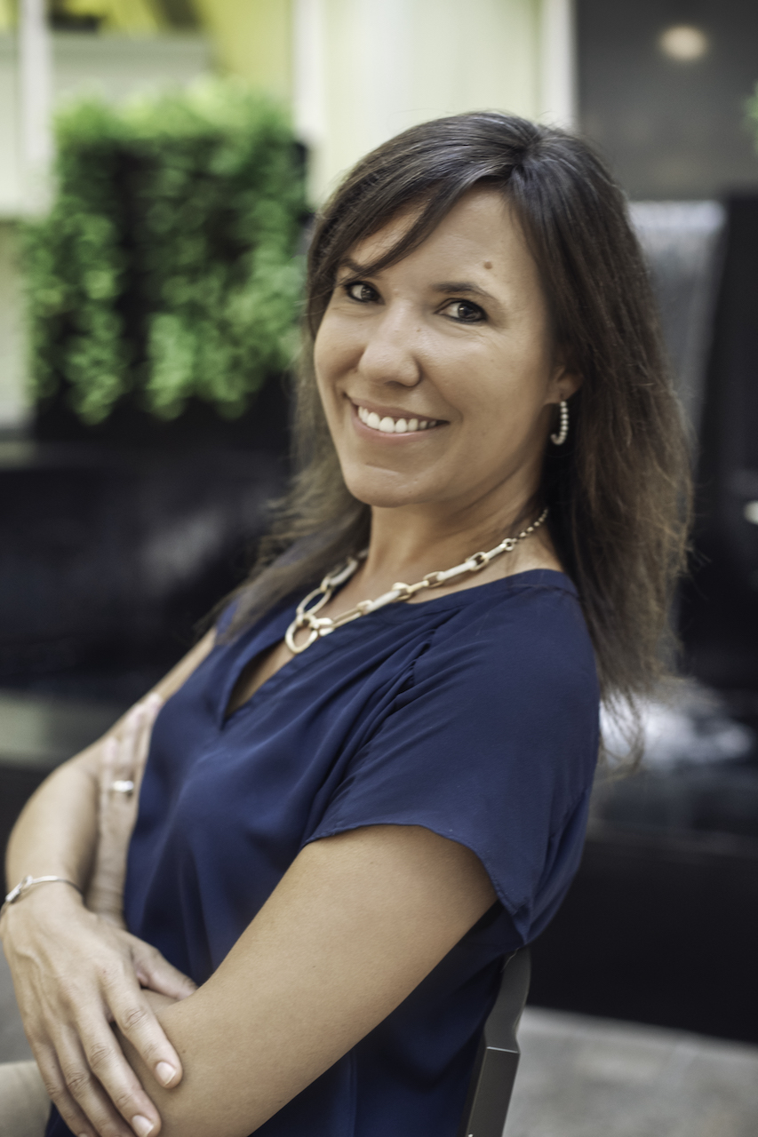
Tuesday, June 13, 2023 (Breakout Session)
It’s About People, Not Programs: Leveraging Differentiated Support to Build Principal Capacity
Dr. Deanna Jaskolski Corbin Edginton Dr. Lindsay Prendergast

Slide 12
Tuesday, June 13, 2023 (Breakout Session)
A Path to Benefits-Based Accountability
for K-12 Schools
John Tanner, BravEd

Slide 13
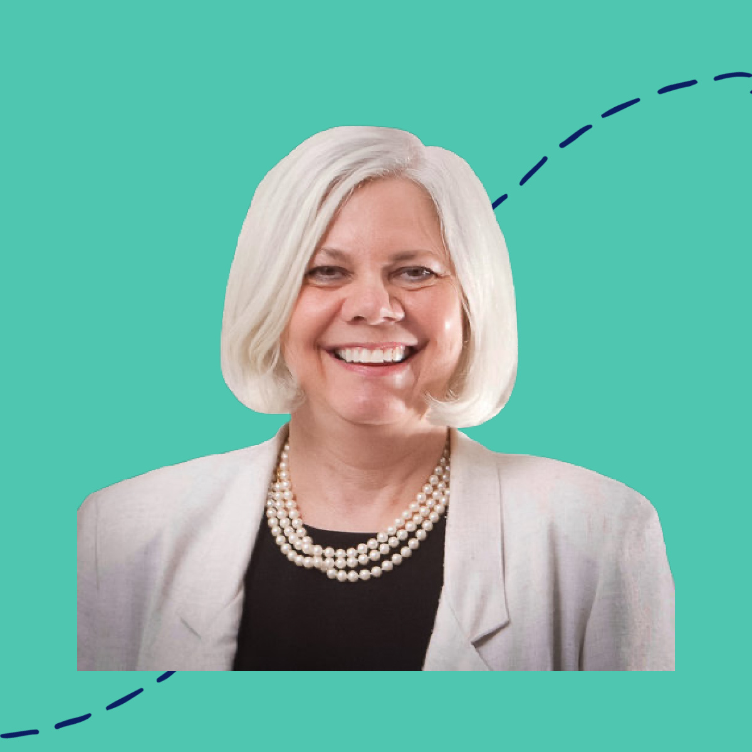
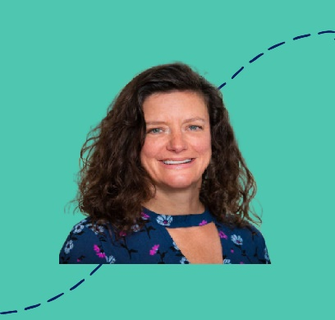
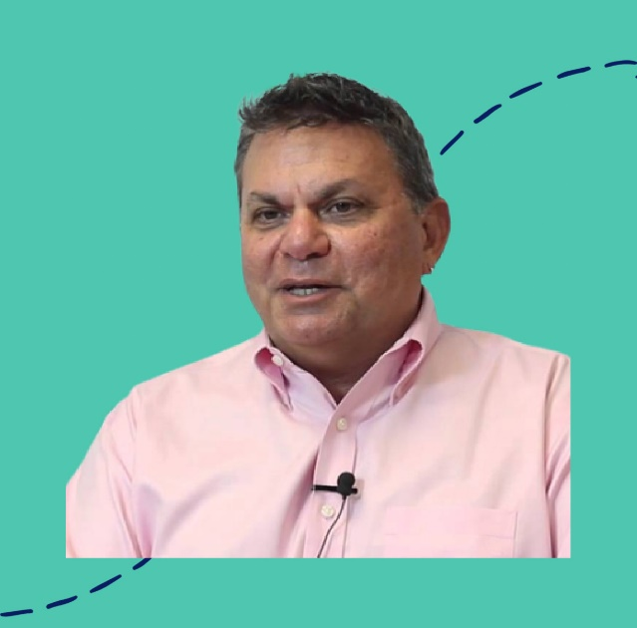
Tuesday, June 13, 2023 (Breakout Session)
Future of Learning 9:00 - 11:10 a.m. - Portrait of a Learner
11:25 a.m. - 1:30 p.m. - Lunch + Keynote
1:45 – 3:45 p.m. – Next Steps for the Future of
Learning Network
Jeanine Collins – Dr. Pam Moran
Laura Hilger – Ira Socal
.

Slide 14
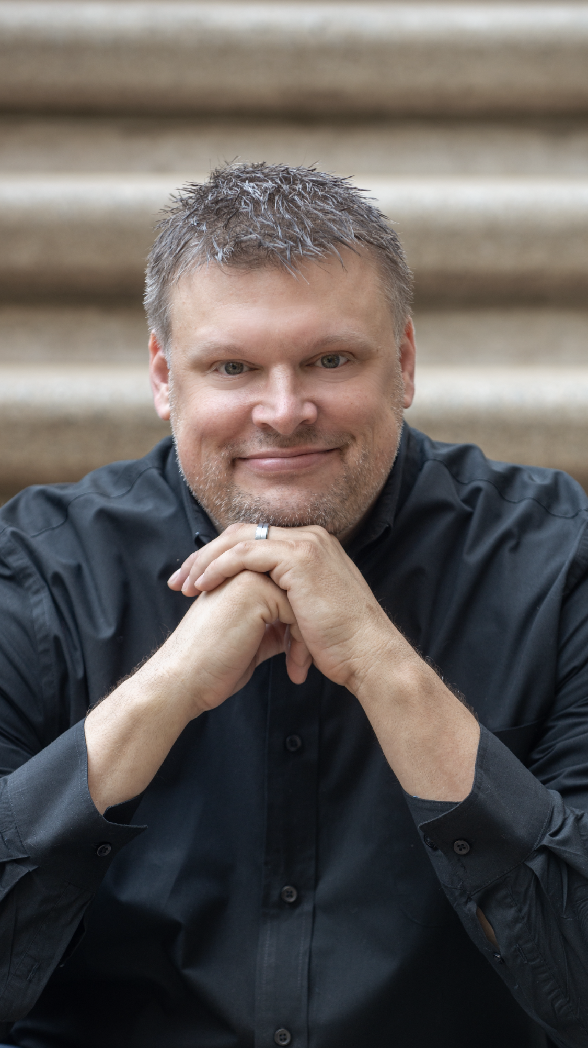
Tuesday, June 13, 2023
Sam Glenn, Speaker, Author
Luncheon Keynote
Attitude Changes Everything
Website
https://www.samglenn.com/

Slide 15
Additional Information
Registration
Opens June12th @ 11:00 a.m. - Sand Harbor I
Exhibits
Open June 12th @ Noon - Sand Harbor I
Hotel
Harrah’s Lake Tahoe, 15 US-50, Stateline, NV 89449
Free parking for hotel guests
Credit Hours Towards License Renewal
7.5 hours - Superintendents Academy
2 hours - NV Future Learning Network afternoon session
3.5 - 4 hours - NASS meeting

